Slide 1
Employee Data Analysis using Excel
STUDENT NAME:MONIKA M
REGISTER NO:22CCA020
DEPARTMENT:BCOM(COMPUTER APPLICATION)
COLLEGE:MOHAMED SATHAK COLLAGE ARTS AND SCIENCE

Slide 2
PROJECT TITLE
Employee Performance Analysis using Excel

Slide 3


AGENDA
Problem Statement
Project Overview
End Users
Our Solution and Proposition
Dataset Description
Modelling Approach
Results and Discussion
Conclusion
3/21/2024 Annual Review

Slide 4

PROBLEM STATEMENT
Context:
Describe the broader field or situation where the problem exists.
Problem Description:
Clearly define the specific issue or challenge.
Impact:
Explain who or what is affected and how they are impacted.
Current Solutions:
Mention any existing efforts or solutions and their limitations.
Gap or Need:
Highlight any gaps or shortcomings in current solutions that need addressing.
Proposed Approach:
Briefly describe the proposed solution or approach.
Expected Outcome:
State the desired results or benefits of addressing the problem.

Slide 5
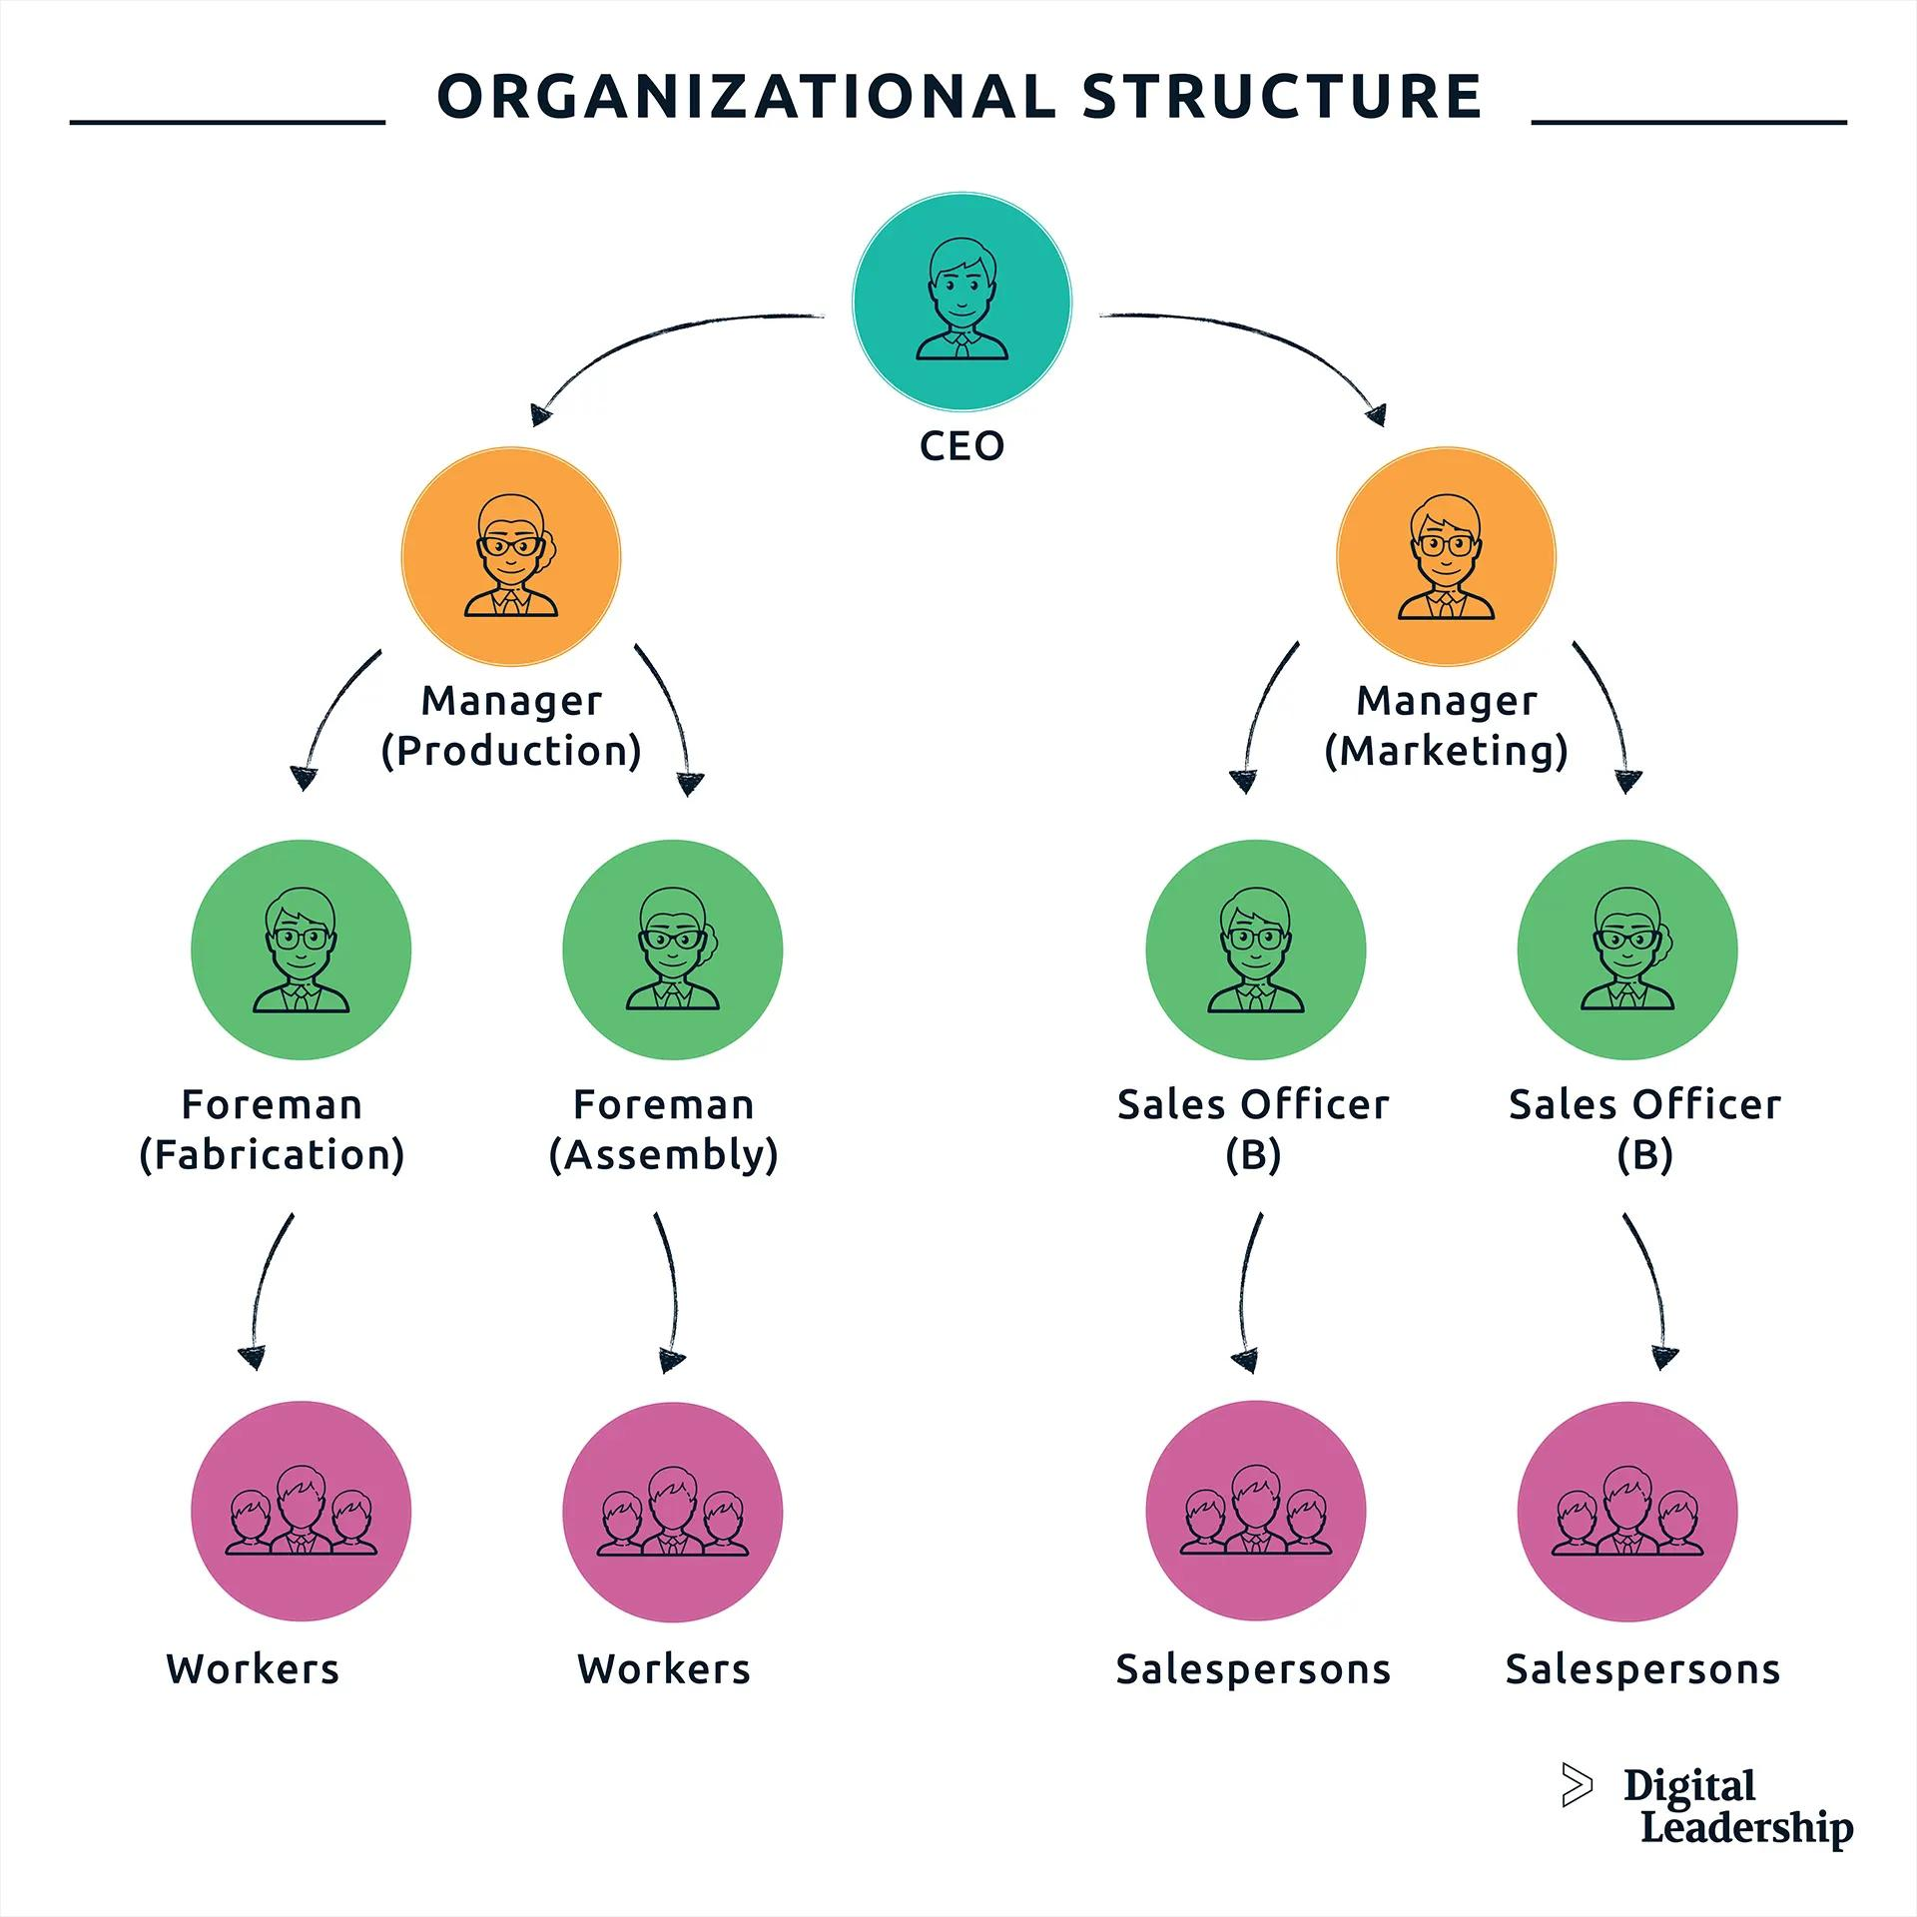
ORGANISATION STRUCTURE

Slide 6

PROJECT OVERVIEW
Description: The RetailX Mobile Application Development project aims to create a user-friendly mobile app to enhance customer engagement and streamline the shopping experience for RetailX, a leading retail company.
Purpose: The project addresses the need for a modern, integrated platform that supports online shopping, personalized promotions, and customer feedback, aiming to boost sales and customer satisfaction.

Slide 7

OUR SOLUTION AND ITS VALUE PROPOSITION
Informed Decision-Making:
Provides managers and executives with data-driven insights to make strategic decisions about promotions, resource allocation, and organizational improvements.
2. Targeted Training and Development:
Identifies specific skill gaps and areas for improvement, allowing HR and training teams to create effective, targeted training programs.
3. Enhanced Employee Engagement:
Offers employees clear feedback on their performance, which boosts motivation, engagement, and alignment with the organization’s goals.
4. Optimized Compensation and Rewards:
Ensures that compensation strategies are fair and performance-based, helping to retain high performers and motivate the workforce.
5. Organizational Improvement and Growth:
Supports continuous improvement by identifying areas where the organization can invest in development and drive overall growth.

Slide 8

WHO ARE THE END USERS?
Individual Consumers:
Description: Individuals who use a product or service for personal needs or enjoyment.
Example: A mobile app designed for fitness tracking will have individual users who track their workouts, set goals, and monitor progress.
Business Users:
Description: Employees or representatives of organizations who use a product or service as part of their work activities.
Example: A customer relationship management (CRM) system will have business users such as sales representatives and customer service agents who use the system to manage customer interactions and data.
Administrators:
Description: Users responsible for managing and maintaining the product or service, often including system settings, user access, and data management.
Example: In a web-based application, administrators might manage user accounts, configure system settings, and oversee data security.
Stakeholders:
Description: Individuals or groups who have a vested interest in the success of the product or service but may not directly use it.
Example: Investors, project sponsors, or executives who are interested in the outcomes but do not interact with the product daily

Slide 9
DATASET DESCRIPTION
Employee ID
First Name
Last Name
Gender
Performance Score
Current Employee Rating

Slide 10
THE“WOW”IN OUR SOLUTION
PERFORMANCE ANALYSIS FORMULA
=IFS(G5>=3,”VERY HIGH”,G5>=4,”
HEIGHT”,G5>=3,”MED”,TRUE,”LOW”)

Slide 11
MODELLING
Data collection
Step 1: Define the Problem and Objectives- Identify the goals of the analysis (e.g., employee turnover, performance, engagement)- Determine the key questions to answer
Step 2: Choose a Dataset- Search for relevant employee datasets on Kaggle (e.g., HR Analytics, Employee Attrition)- Select a dataset that aligns with your objectives
Step 3: Import and Explore the Data- Import the dataset into a Kaggle notebook or Excel- Explore the data using summary statistics, visualizations, and data profiling
Feature collection
- HR systems (e.g., Workday, BambooHR)- Performance management tools (e.g., Lattice, 15Five)- Employee engagement surveys (e.g., Culture Amp, SurveyMonkey)- Time-off and attendance systems (e.g., ADP, Namely)- Training and development platforms (e.g., Udemy, LinkedIn Learning)
11

Slide 12
RESULTS
12

Slide 13
CONCLUSION
“Data analysis is not just about number its about numbers its about telling a story that drives action and improves employee lives."

